Slide 1
Mute Heart
IoT-Enabled Wearable Gesture Recognition Glove
for Sinhala Sign Language Voice Translation
Final IoT Project Report | Group 19
COHNDSE25.2F-069 – N D D I Pramuditha
COHNDSE25.2F-015 – L H S Senethma
COHNDSE25.2F-055 – G A A E Perera
Lecturer: Mr. Bathiya Seneviratne
National Institute of Business Management
School of Computing and Engineering | HNDSE

Slide 2
Introduction
The Problem
Our Solution
Hearing and speech-impaired individuals rely on Sri Lankan Sign Language (SSL) to communicate.
However, most of the general public does not understand SSL, creating a serious communication barrier in daily life, healthcare, and public services.
Traditional camera-based recognition systems require controlled environments and high computational power — not suitable for everyday portable use.
"Mute Heart" — a wearable IoT gesture recognition glove
Translates selected Sinhala sign language gestures into audible Sinhala speech in real time using:
• ESP32 Microcontroller for processing
• 5 Rotary Potentiometers for finger angles
• MPU6050 Motion Sensor for hand orientation
• DFPlayer Mini for Sinhala audio output
Currently demonstrates 5 Sinhala vowel gestures: අ, ආ,
ඇ ,එ, ඒ, උ

Slide 3
Sensors & Actuators
Rotary Potentiometers (×5)
MPU6050 (IMU Sensor)
Attached to each finger of the glove. Detects angular bending of fingers by producing an analog voltage proportional to the bend angle. Enables precise gesture differentiation.
6-axis inertial measurement unit capturing hand motion and orientation data (gyroscope + accelerometer). Helps identify full hand gestures beyond finger bending.
ESP32 Microcontroller
DFPlayer Mini + Speaker
Main processing unit. Collects analog signals from potentiometers and digital data from MPU6050. Applies rule-based threshold mapping to classify gestures.
Audio output module. Receives gesture commands from ESP32 and plays pre-recorded Sinhala audio files through a connected speaker to produce voice output.

Slide 4
Arduino Program
[Code Demonstration]

Slide 5
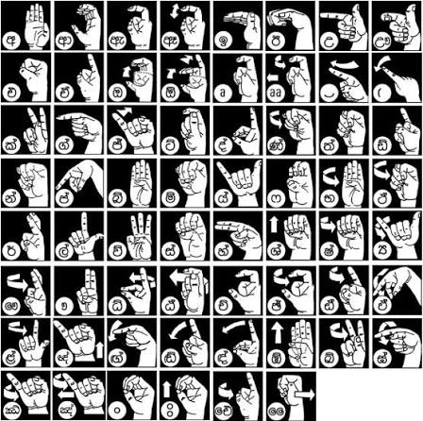
Demonstration
[Live Demonstration]

Slide 6
Thank You
Mute Heart — IoT Gesture Recognition Glove
for Sinhala Sign Language Voice Translation
Group 19 | HNDSE | NIBM
Mr. Bathiya Seneviratne — Lecturer

